Slide 1
ClusterBots: A Modular Robotic architecture for shared Autonomy and Resources
Swarnabha Roy

Slide 2
Introduction
The importance of coordination among multiple robots has grown significantly over the past few years.
Establishing proper coordination among different individual robots will enable more applications but it still needs a lot of refinement.
The emergence of Cloud robotics provides an efficient alternative for offloading the physical computations from the robot to a cloud computing infrastructure.
In this work, we propose a new modular robotic architecture called ClusterBots where various modular robotic clusters work together by sharing information via a Cloud Server.

Slide 3
Previous Work
Networked Robotics [1] has been the classical name given to robots connected over a network for functional collaboration.
K. Goldberg et al. [2] were the first to connect a robot to the World Wide Web and control it through a web browser.
‘RoboEarth’ [3] which connected robots worldwide and discussed the key requirements for information sharing among robots, including performance optimization.
Smart Cloud [6] tries to mitigate this problem by using a JavaScript-based framework for application development.
In 2017, a new protocol called RosLink [8] was proposed to overcome the limitations of ROS over a Wide Area Network (WAN).

Slide 4
The current challenges
For many applications, creating a monolithic entity that can address all aspects of a problem can be very expensive and complex; instead, creating multiple, more specialized entities that can share the workload offers the possibility of reducing the complexity of the individual entities.
"distributed intelligent systems may require more communication to coordinate all the entities in the system as they must actwithout complete knowledge of the other entities’ intents. Finally, systems of multiple entities will typically experience increased uncertainty about the state of the system as a whole."

Slide 5

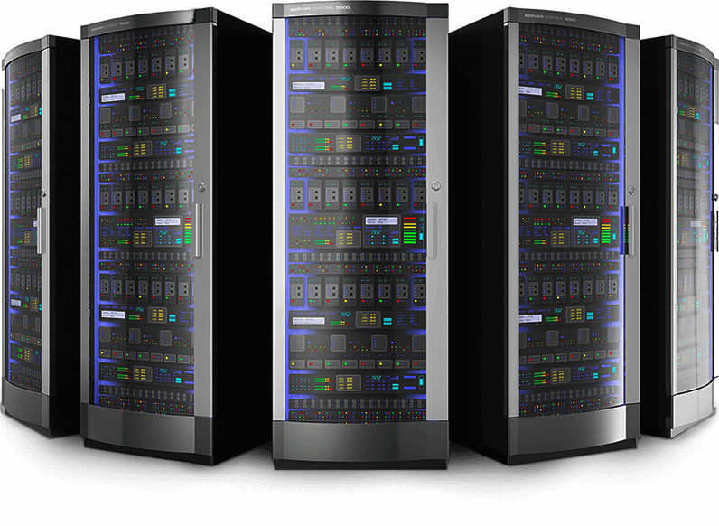
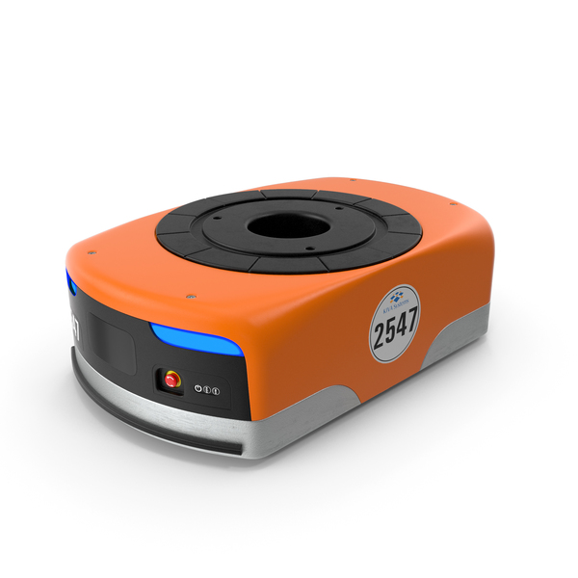
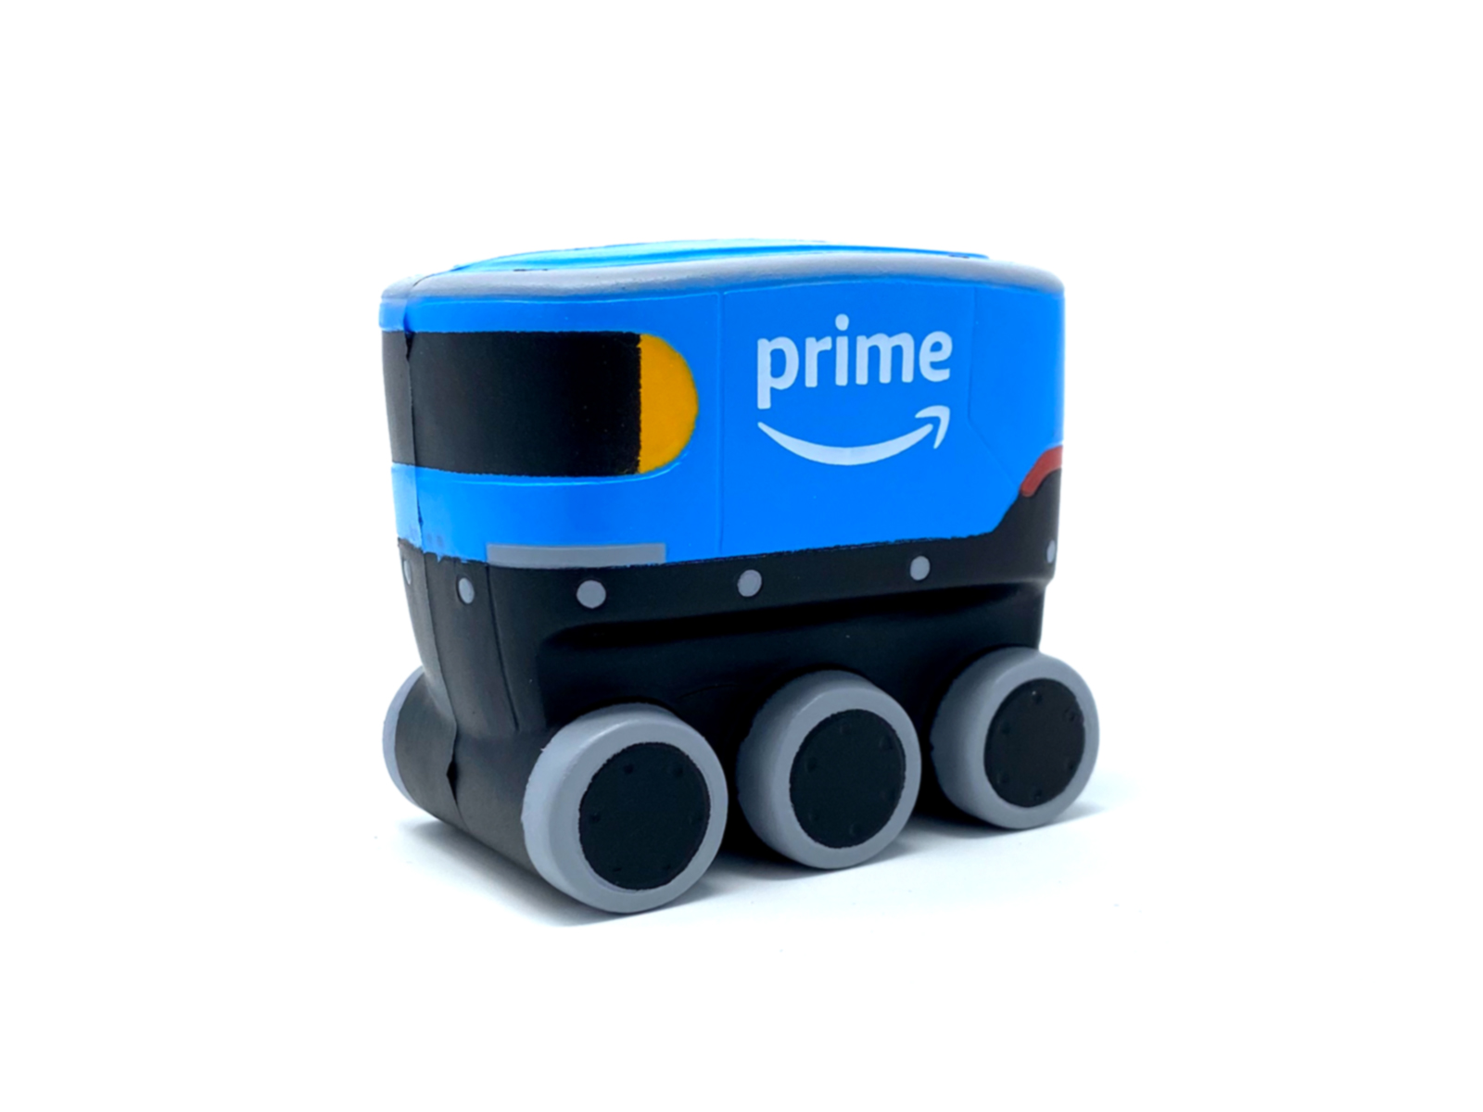
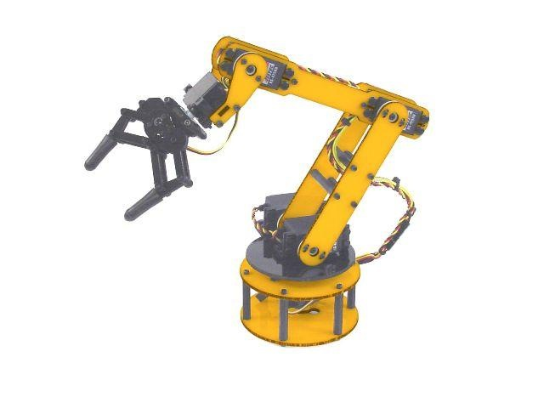
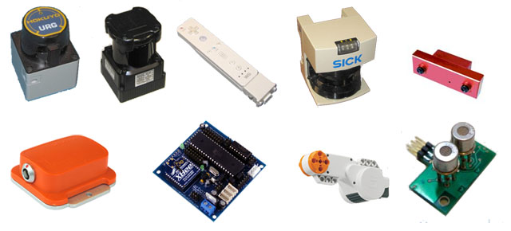
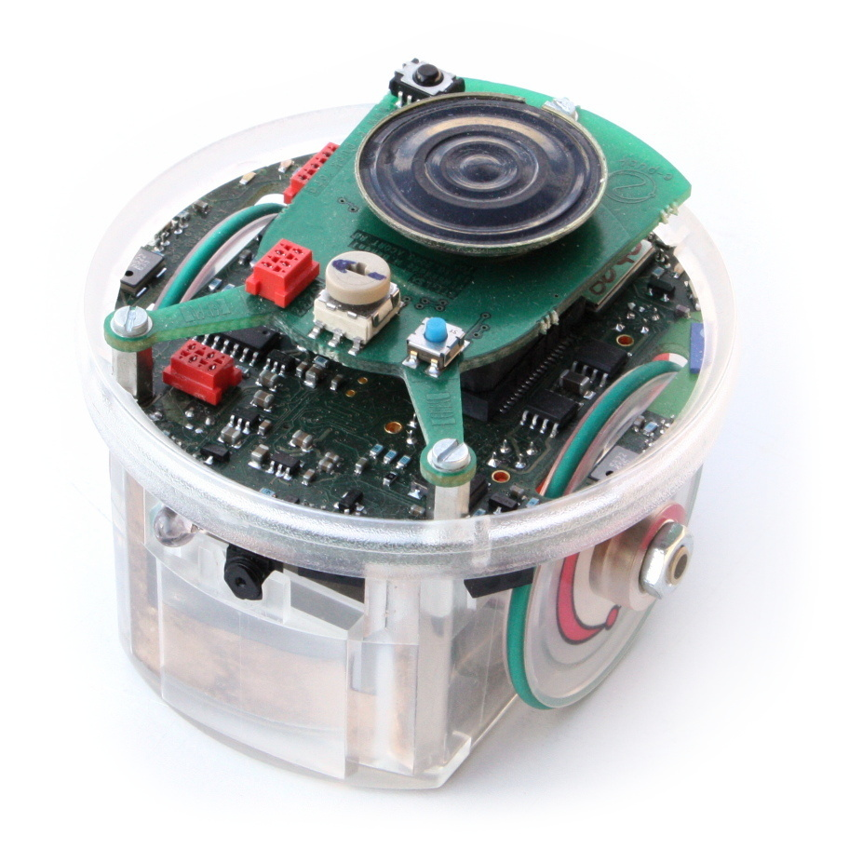
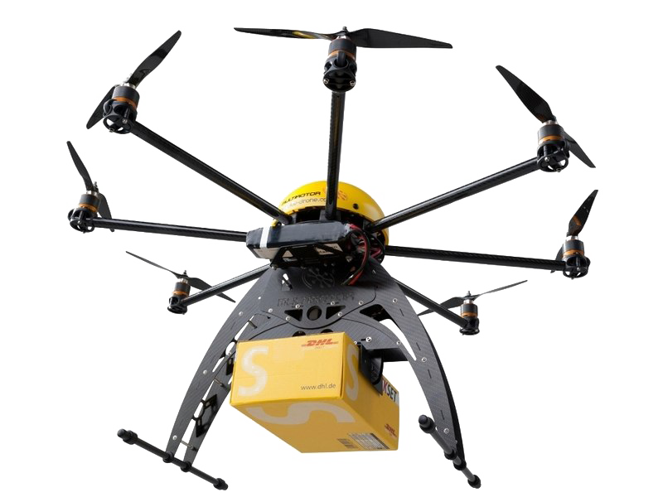
The proposed architecture
Communication via ROS Topics and sockets
Communication via ROS Topics and sockets
Cluster Node 1: Running Client ROS
Cluster Node 3: Running client ROS
AWS Cloud Server running the ROS master
Cluster Node 2: Running client ROS

Slide 6
Project Plan
Initial Framework
ROS Cloud Server setup
Create Robot LAN
Inter module Sensor Fusion
Connected intelligence among sub modules
Test data throughput
Shared autonomy
Fallback behaviour when connection is lost
Dynamic computation offloading
Setup Modular WAN
Security
Local Sensor Fusion
Develop a universal communication protocol across sensors
Online and offline data storage handling
Test Fault tolerance

Slide 7
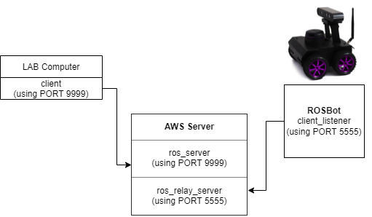

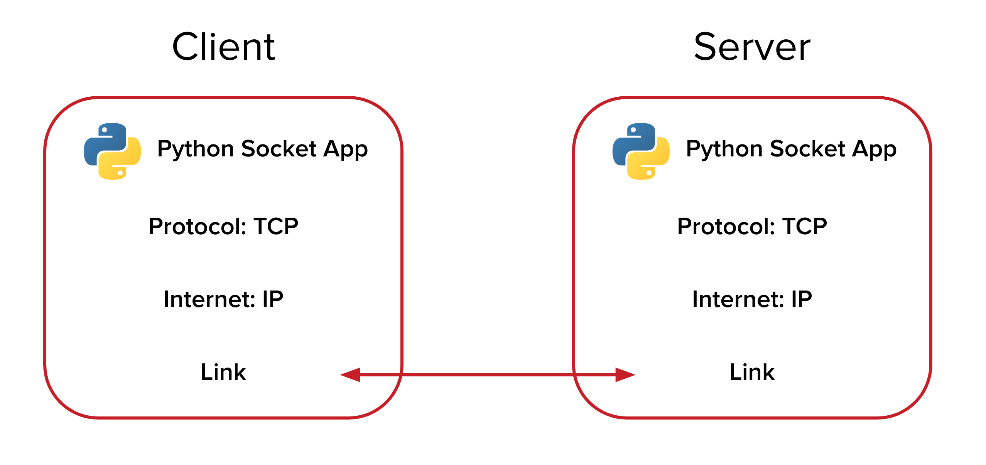
Our approach
Services used
Experiment rough sketch

Slide 8
VIDEO DEMO

Slide 9
References
Haidegger, Tamás, Péter Galambos, and Imre J. Rudas. "Robotics 4.0–Are we there yet?." 2019 IEEE 23rd International Conference on Intelligent Engineering Systems (INES). IEEE, 2019.
K. Goldberg, M. Mascha, S. Gentner, N. Rothenberg, C. Sutter, and J. Wiegley, “Desktop teleoperation via the world wide web,” in Proceedings of 1995 IEEE International Conference on Robotics and Automation, vol. 1, May 1995, pp. 654–659 vol.1
Waibel, Markus, Michael Beetz, Javier Civera, Raffaello d'Andrea, Jos Elfring, Dorian Galvez-Lopez, Kai Häussermann et al. "Roboearth." IEEE Robotics & Automation Magazine 18, no. 2 (2011): 69-82.
J. Kuffner, "What's Next: Cloud-Enabled Humanoids?" in 10th IEEE-RAS International Conference on Humanoid Robots (Humanoids 2010) Workshop, 2010.
Fierro, Rafael, Aveek Das, John Spletzer, Joel Esposito, Vijay Kumar, James P. Ostrowski, George Pappas et al. "A framework and architecture for multi-robot coordination." The International Journal of Robotics Research 21, no. 10-11 (2002): 977-995.
Penmetcha, Manoj, Shyam Sundar Kannan, and Byung-Cheol Min. "Smart Cloud: Scalable Cloud Robotic Architecture for Web-powered Multi-Robot Applications." arXiv preprint arXiv:1912.02927 (2019).
Mohanarajah, Gajamohan, Dominique Hunziker, Raffaello D'Andrea, and Markus Waibel. "Rapyuta: A cloud robotics platform." IEEE Transactions on Automation Science and Engineering 12, no. 2 (2014): 481-493.
Koubaa, Anis, Maram Alajlan, and Basit Qureshi. "ROSLink: bridging ROS with the internet-of-things for cloud robotics." Robot Operating System (ROS). Springer, Cham, 2017. 265-283.
Houxiang Zhang, Juan Gonzalez-Gomez, Zhizhu Me, Sheng Cheng and Jianwei Zhang, "Development of a low-cost flexible modular robot GZ-I," 2008 IEEE/ASME International Conference on Advanced Intelligent Mechatronics, 2008, pp. 223-228, doi: 10.1109/AIM.2008.4601663.
Simoens, Pieter, Mauro Dragone, and Alessandro Saffiotti. "The Internet of Robotic Things: A review of the concept, added value, and applications." International Journal of Advanced Robotic Systems 15, no. 1 (2018): 1729881418759424.
Geyer, Charles J. "Practical Markov chain monte carlo." Statistical science (1992): 473-483.
Zykov, Victor, Andrew Chan, and Hod Lipson. "Molecubes: An open-source modular robotics kit." IROS-2007 Self-Reconfigurable Robotics Workshop. 2007.
Yan, Zhi, Nicolas Jouandeau, and Arab Ali Cherif. "A survey and analysis of multi-robot coordination." International Journal of Advanced Robotic Systems 10.12 (2013): 399.
Parker, Lynne E. "Distributed Intelligence: Overview of the Field and its Application in Multi-Robot Systems." AAAI fall symposium: regarding the intelligence in distributed intelligent systems. 2007.

Slide 10
THANK YOU

